Slide 1
USING
SPIN ANIMATION
CUSTOM SLIDE
TRANSITION

Slide 2
USING
GROW/ SHRINK
ANIMATION
CUSTOM SLIDE
TRANSITION

Slide 3
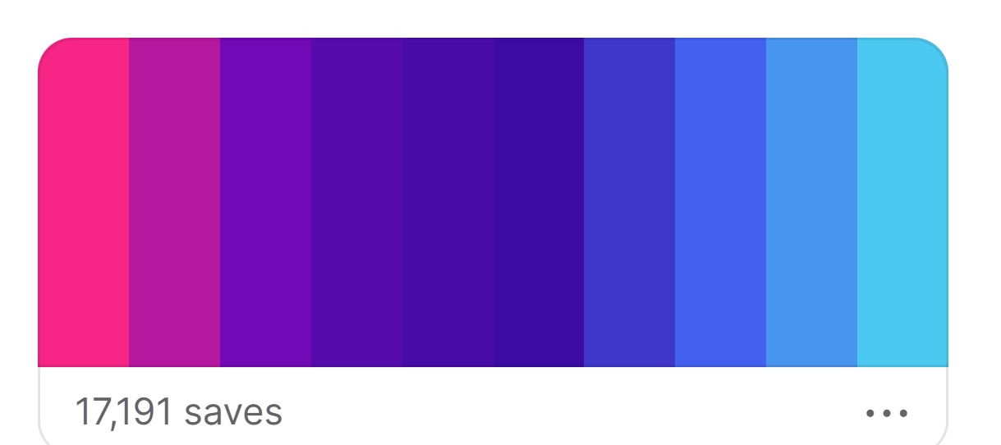
USING
ZOOM
ANIMATION
CUSTOM SLIDE
TRANSITION

